Slide 1
Data Visualization
ISTP Summer JC
Anthony Hung

Slide 2
Outline
Data visualization: Data exploration vs Data explanation
Tips/Tricks/Resources
Grammar of Graphics
Exercise in R: ggplot2

Slide 3
Data visualization is important not only to present data to others, but to better understand it yourself
Data exploration
Find the message in the data
Quality Control of data
Usually not very visually appealing
Often requires generating many visualizations to look at the data from multiple angles
Breadth over depth
Data explanation
Present the message in the data to others (who may or may not be familiar with your work)
Paying attention to aesthetics and simplicity becomes important
Depth over breadth

Slide 4
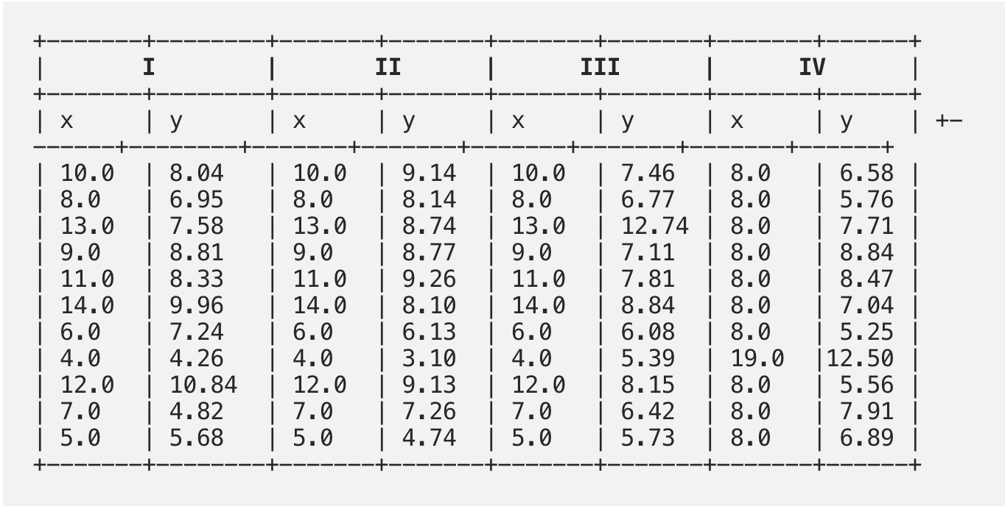
Data exploration
https://towardsdatascience.com/fables-of-data-science-anscombes-quartet-2c2e1a07fbe6

Slide 5
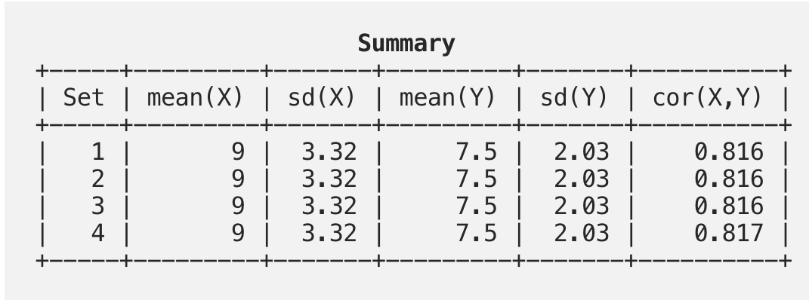
Data exploration
https://towardsdatascience.com/fables-of-data-science-anscombes-quartet-2c2e1a07fbe6

Slide 6
Visualization reveals hidden relationships
Heathcote, Andrew & Brown, Scott & Wagenmakers, Eric-Jan. (2015). An Introduction to Good Practices in Cognitive Modeling. 10.1007/978-1-4939-2236-9_2.

Slide 7
What are useful exploratory visualizations for…
Continuous data?
Categorical data?
Bivariate continuous data?
Bivariate data with one continuous and one categorical?
Time series data?
High-dimensional data?

Slide 8
What are useful exploratory visualizations for…
Continuous data? (histogram/ECDF)
Categorical data? (bar plot/pie chart/pie chart alternatives)
Bivariate continuous data? (scatter plot)
Bivariate data with one continuous and one categorical?
Time series data?
High-dimensional data?

Slide 9
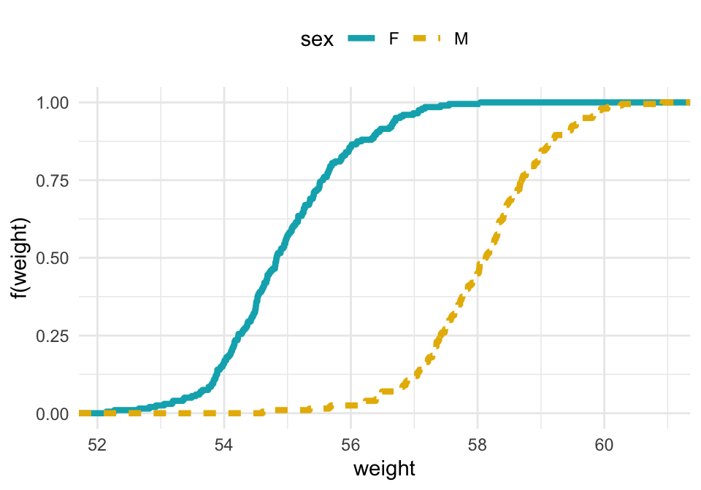
Empirical Continuous Distribution Function

Slide 10
Of course… exploratory data analysis involves more than just plots
Statistical exploratory data analysis is still important
Summary statistics (”statistic” means a function of the data, ”summary” means that function outputs a number that represents the data)
Measures of central tendency
Measures of spread
Correlation/Covariance

Slide 11
Data explanation
Summarize information and present in a meaningful, non-confusing, non-manipulative way
Consider what the message of each visual is, and use tools to best present that message
Best type of chart
Best way to discriminate datapoints

Slide 12
Choosing the right type of chart
https://datavizcatalogue.com/
http://datavizproject.com/
https://github.com/ft-interactive/chart-doctor/blob/master/visual-vocabulary/poster.png?raw=true
http://chartmaker.visualisingdata.com/
https://xeno.graphics/

Slide 13
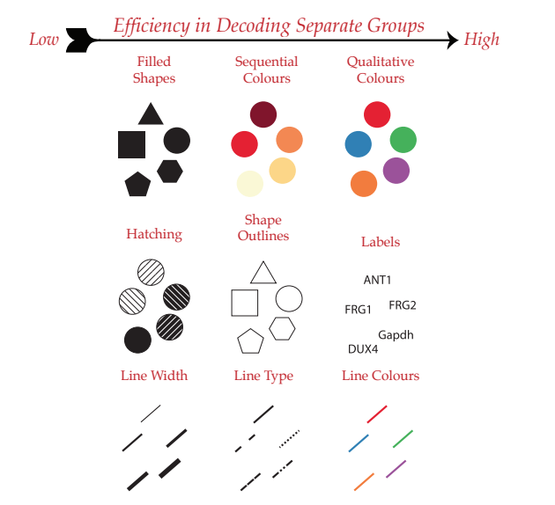
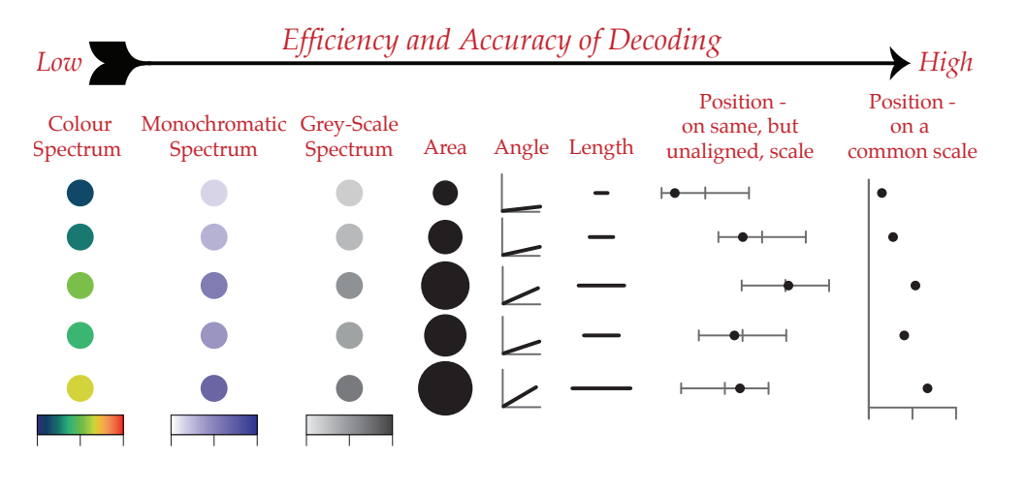
Discriminating between datapoints
Categorical Variables
Continuous Variables
Datacamp.com

Slide 14
Choosing color palettes
https://color.adobe.com/explore
https://coolors.co/fcfafa-c8d3d5-a4b8c4-6e8387-0cca4a

Slide 15
Missteps to avoid
Default ordering/Alphabetical ordering hides patterns in data
Not all the data tells a story (emphasize the important data)

Slide 16
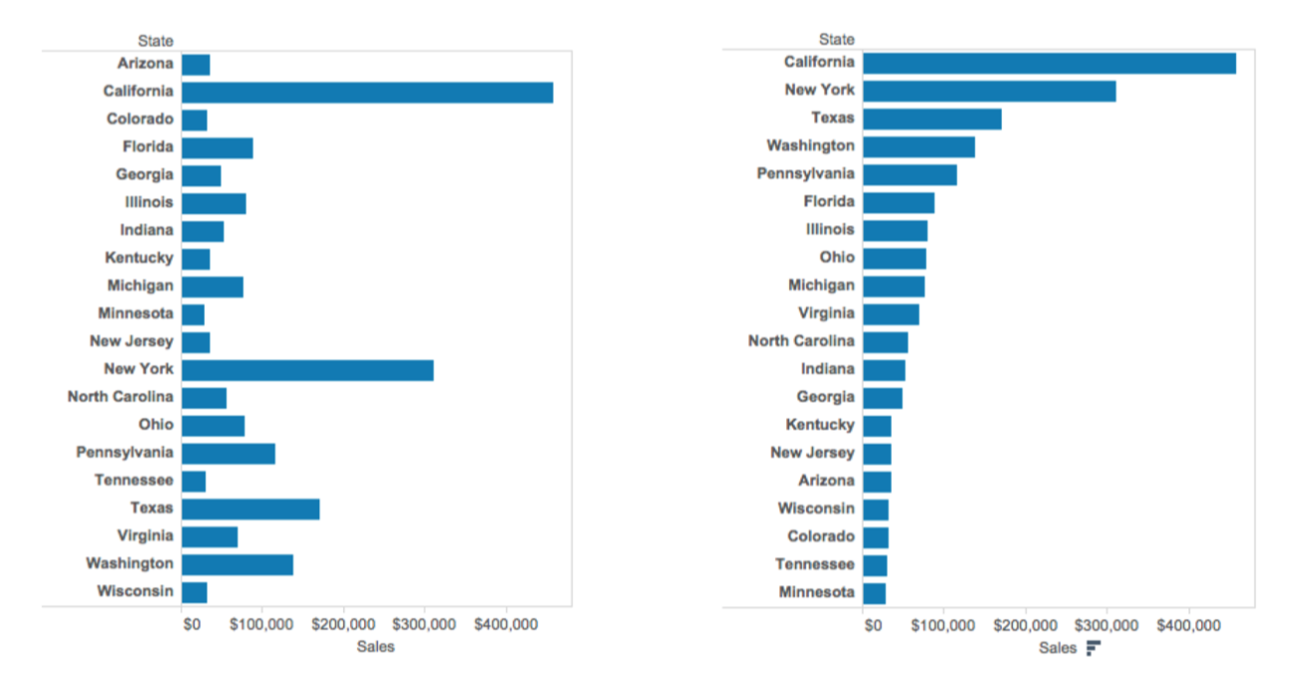
Default ordering/Alphabetical ordering hides patterns in data

Slide 17
Default ordering/Alphabetical ordering hides patterns in data

Slide 18
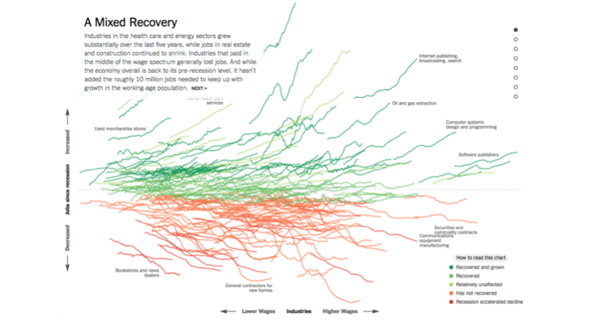
Not all the data tells a story
https://www.nytimes.com/interactive/2014/06/05/upshot/how-the-recession-reshaped-the-economy-in-255-charts.html

Slide 19
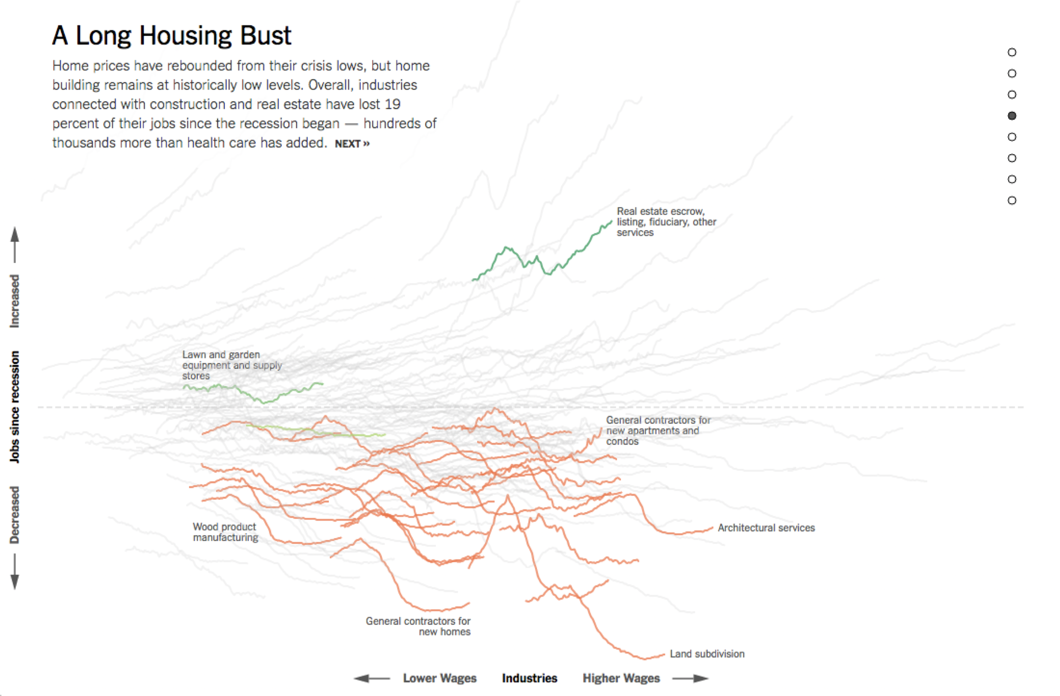
Not all the data tells a story (depth over breadth)
https://www.nytimes.com/interactive/2014/06/05/upshot/how-the-recession-reshaped-the-economy-in-255-charts.html

Slide 20
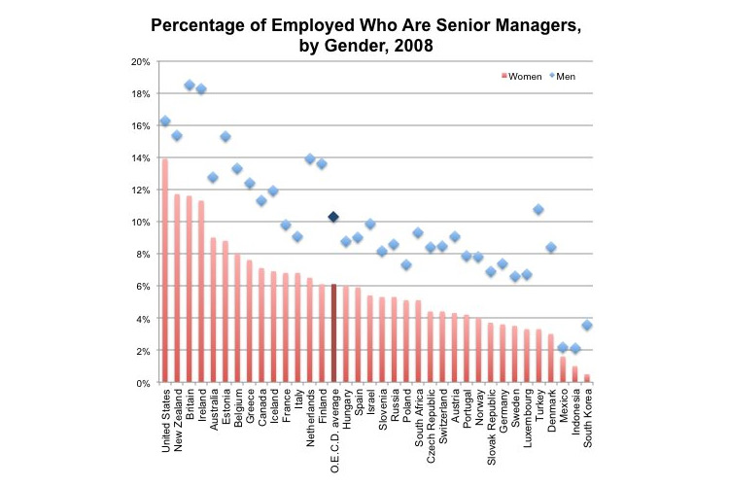
Critique/Fix some issues
http://economix.blogs.nytimes.com/2013/04/02/comparing-the-worlds-glass-ceilings/?smid=tw-share
http://webcache.googleusercontent.com/search?q=cache:hl7F7jJRd6YJ:thewhyaxis.info/gap-remake/+&cd=1&hl=en&ct=clnk&gl=us
Notes:
What’s good about this plot? (order from greatest to least)

Slide 21
Notes:
Rotate text to be easily readable

Slide 27
Grammar of Graphics
Grammar: framework that defines and establishes the structure of a language. If words are the lego blocks of language, grammar is the instruction booklet for how to put them together to make meaningful sentences.
A grammar of graphics is a framework that breaks down any graphic into its components (layers) to allow us to concisely describe it.

Slide 28
Layers of any visualization
Data: Always start with the data, identify the dimensions you want to visualize.
Aesthetics: Confirm the axes based on the data dimensions, positions of various data points in the plot. Also check if any form of encoding is needed including size, shape, color and so on which are useful for plotting multiple data dimensions.
Scale: Do we need to scale the potential values, use a specific scale to represent multiple values or a range?
Geometric objects: These are popularly known as ‘geoms’. This would cover the way we would depict the data points on the visualization. Should it be points, bars, lines and so on?
Statistics: Do we need to show some statistical measures in the visualization like measures of central tendency, spread, confidence intervals?
Facets: Do we need to create subplots based on specific data dimensions?
Coordinate system: What kind of a coordinate system should the visualization be based on — should it be cartesian or polar?

Slide 29
https://github.com/altair-viz
Notes:
Example of a graphic, walk through each component in action (emphasize that not all layers will be used in each graphic)

Slide 30
Exercise in R
Ggplot2 cheat sheet:
https://rstudio.com/wp-content/uploads/2015/03/ggplot2-cheatsheet.pdf

Slide 31
References
Everything Data course: “Effective Visualizations”, Duke University

